Slide 1

STOCK PRICE PREDICTION
Using PCA & LSTM
01

Slide 2

TABLE OF CONTENTS
01
02
03
04
INTRODUCTION
CONCEPT
Objective - What are we trying to achieve through this project
Explanation of PCA and LSTM (why and how it is used)
How we incorporated PCA & LSTM in our project with code explanation
INFERENCES
CODE
Our observations from the output of the code; Closing statements & final findings
02

Slide 3

01
INTRODUCTION
Brief explanation of how we went about the project
03

Slide 4

INTRODUCTION
Our main objective was to predict stock prices.
To do so, we had to reduce the many features that affect the stock’s price.
We used the Machine Learning algorithm of Principle Component Analysis (PCA) to extract the most important features.
We then had to predict the stock price for today based on yesterday for which we made use of Long Short-Term Memory (LSTM).
04

Slide 5

OUR DATASET
We gathered the required dataset for this project from Yahoo Finance.
We chose two banks to do our analysis on: HDFC & IDFC. We fixed a time period of 5 years for each bank, as this included all the highs & lows.
The reason for choosing HDFC was that it is a very well performing and stable stock which continuously showed profits.
However, on the other hand IDFC was a stock that performed poorly over the chosen time-period. So these two stocks contrasted well.
05

Slide 6
02
CONCEPTS
Explanation of PCA and LSTM
06

Slide 7
What is PCA?
Why PCA?
Principal Component Analysis is an unsupervised learning algorithm that is used for the dimensionality reduction in machine learning.
It is a statistical process that converts the observations of correlated features into a set of linearly uncorrelated features with the help of orthogonal transformation.
It is one of the popular tools that is used for exploratory data analysis and predictive modeling.
It is a technique to draw strong patterns from the given dataset by reducing the variances.
PCA generally tries to find the lower-dimensional surface to project the high-dimensional data.
07
Notes:
PCA

Slide 8
RNN
Problems
Remembers previous data through help of feedback loop
Works well with sequential data as input; ability to process temporal data
Recurrent neural networks recognize data's sequential characteristics and use patterns to predict the next likely scenario.
Long-Term Dependencies
Vanishing & Exploding Gradient
Difficult to adjust when context (time-period) for two things is very different
08
Notes:
LSTM

Slide 9
LSTM
Long Short Term Memory is a kind of recurrent neural network.
In RNN output from the last step is fed as input in the current step.
It tackled the problem of long-term dependencies of RNN in which the RNN cannot predict the word stored in the long-term memory but can give more accurate predictions from the recent information.
As the gap length increases RNN does not give an efficient performance.
LSTM can by default retain the information for a long period of time.
It is used for processing, predicting, and classifying on the basis of time-series data.
09
Notes:
LSTM

Slide 10
03
CODES
Explanation of PCA and LSTM
010

Slide 11
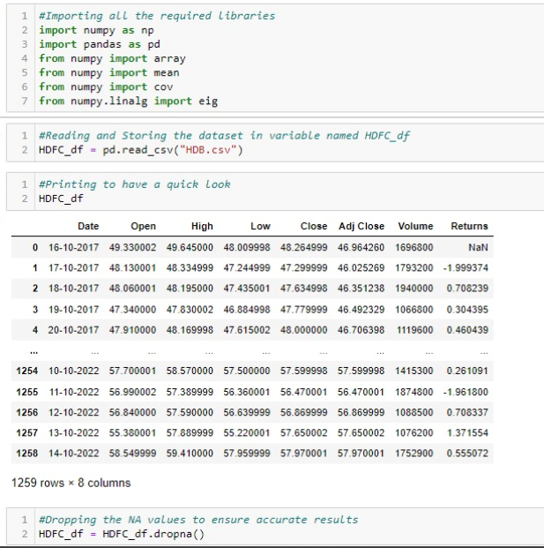
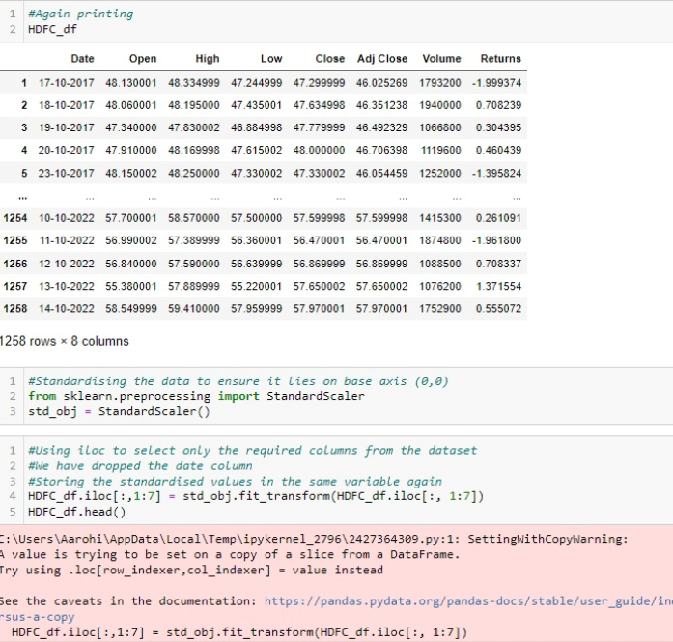
PCA CODE
Mercury
Mercury is the closest planet to the Sun
Venus
Venus has a beautiful name but it’s hot
Mars
Despite being red, Mars is actually a cold place
11

Slide 12
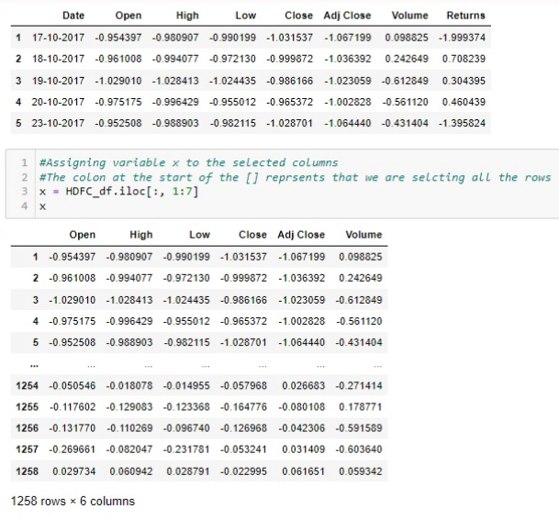
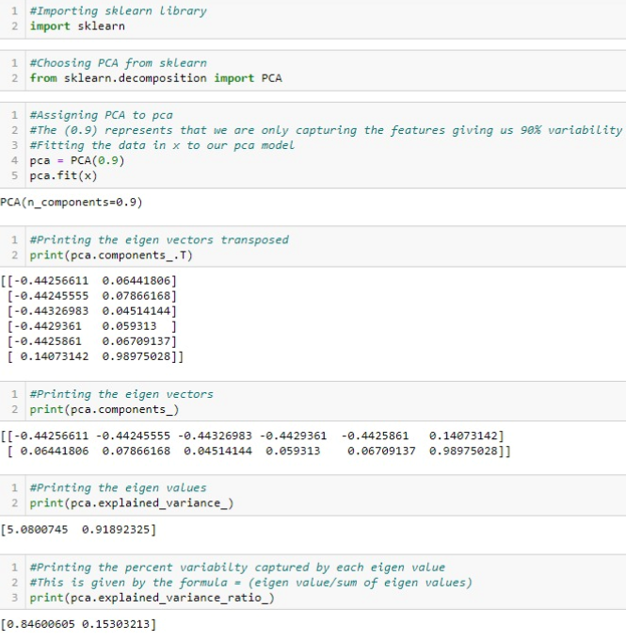
Mercury
Mercury is the closest planet to the Sun
Venus
Venus has a beautiful name but it’s hot
Mars
Despite being red, Mars is actually a cold place
12

Slide 13

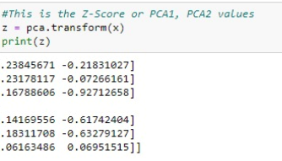
Mercury
Mercury is the closest planet to the Sun
Venus
Venus has a beautiful name but it’s hot
13

Slide 14
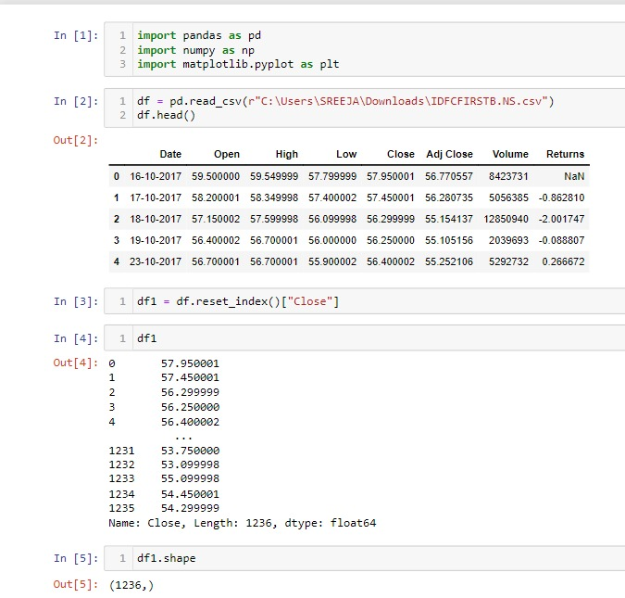
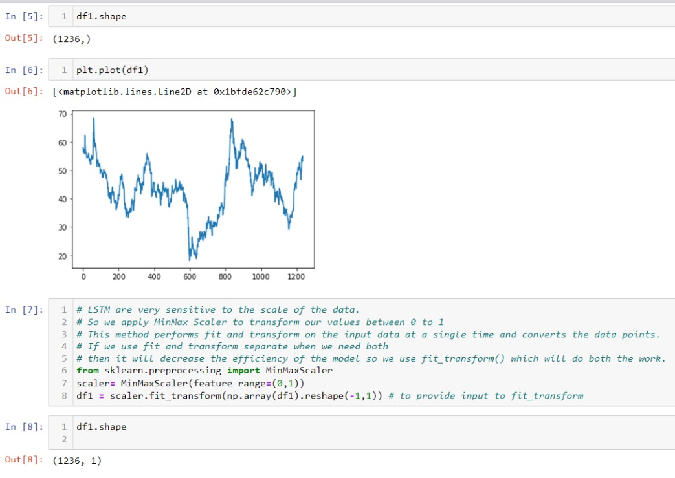
LSTM CODE
Mercury
Mercury is the closest planet to the Sun
Venus
Venus has a beautiful name but it’s hot
Mars
Despite being red, Mars is actually a cold place
14

Slide 15
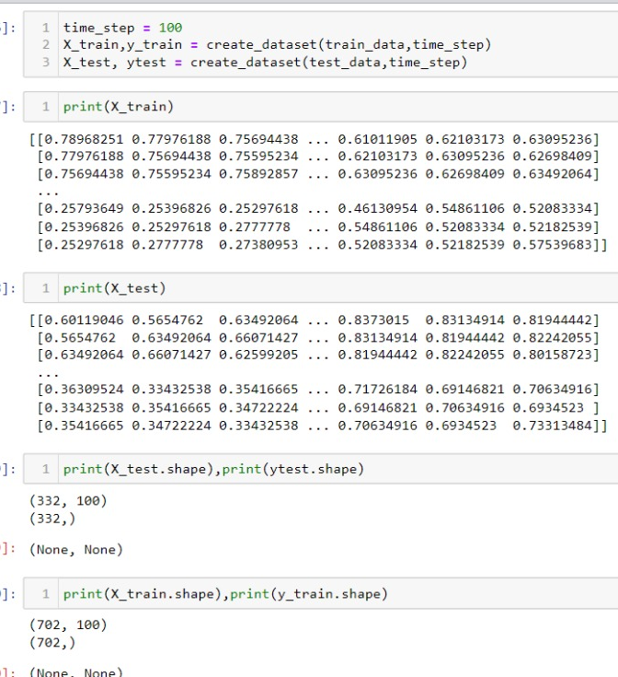
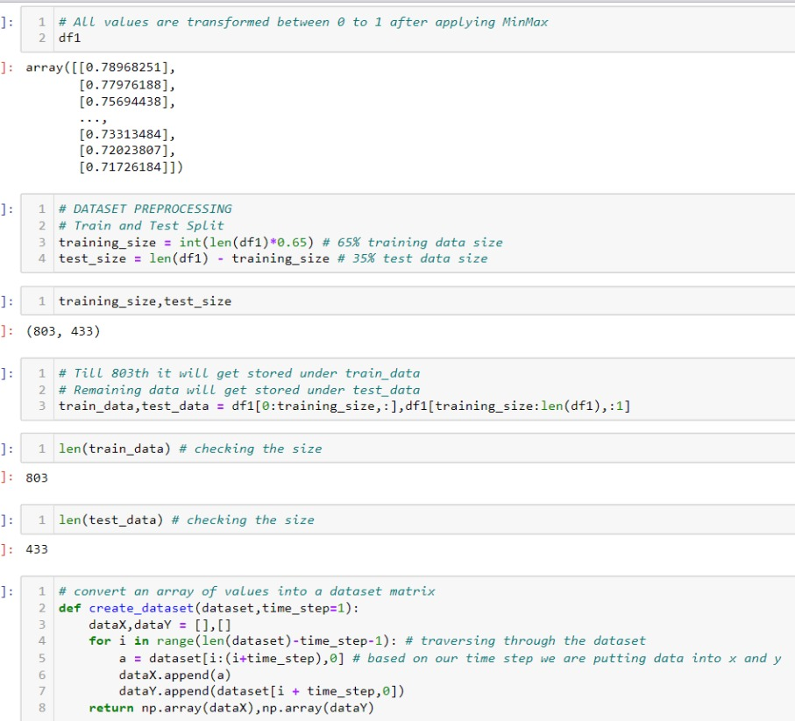
LSTM CODE
Mercury
Mercury is the closest planet to the Sun
Venus
Venus has a beautiful name but it’s hot
Mars
Despite being red, Mars is actually a cold place
15

Slide 16
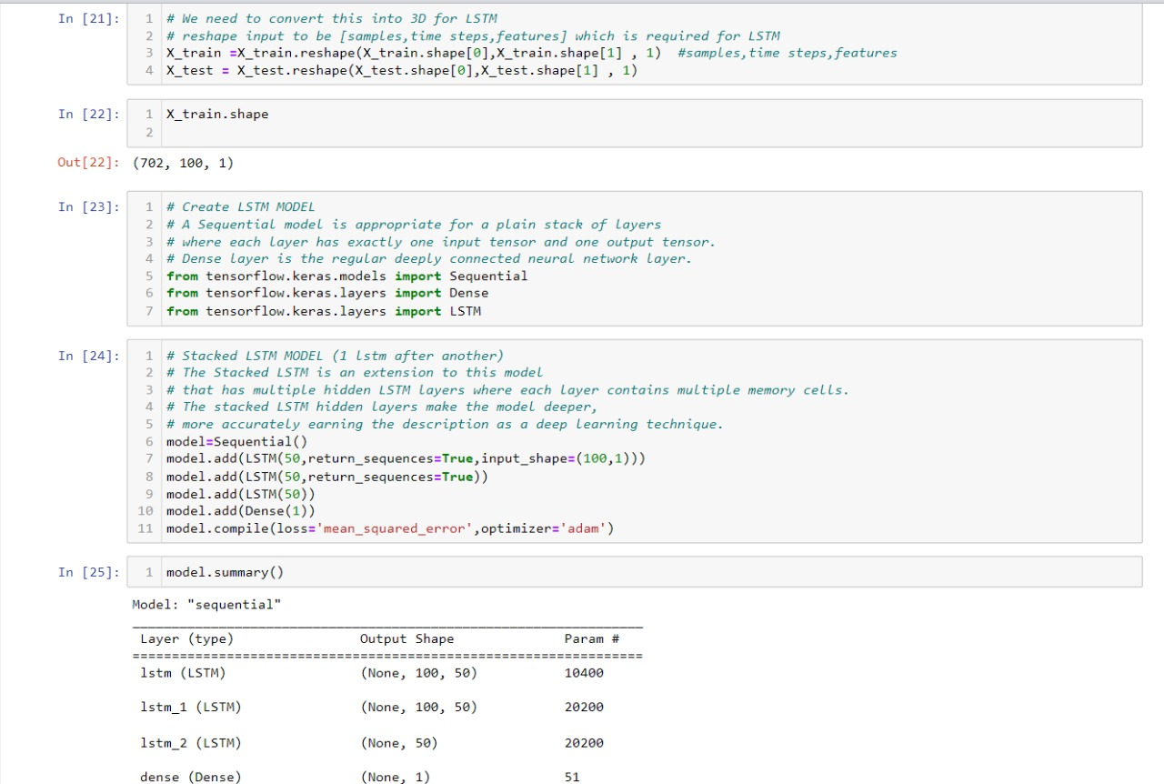
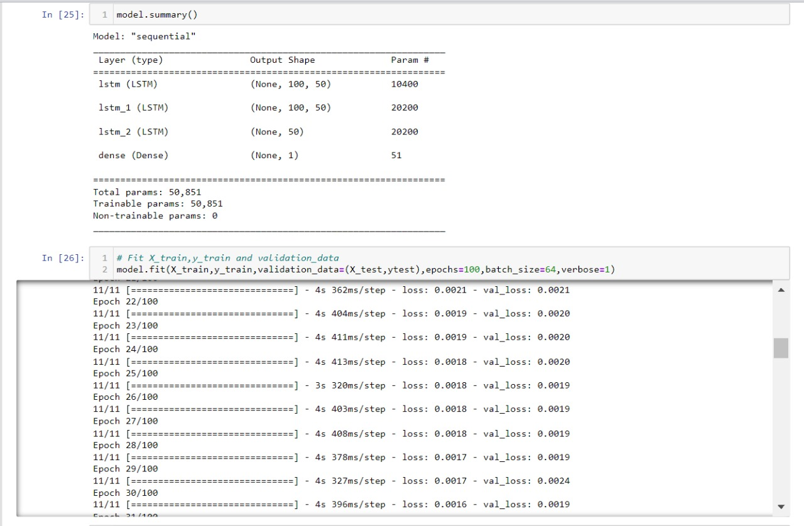
LSTM CODE
Mercury
Mercury is the closest planet to the Sun
Venus
Venus has a beautiful name but it’s hot
Mars
Despite being red, Mars is actually a cold place
16

Slide 17
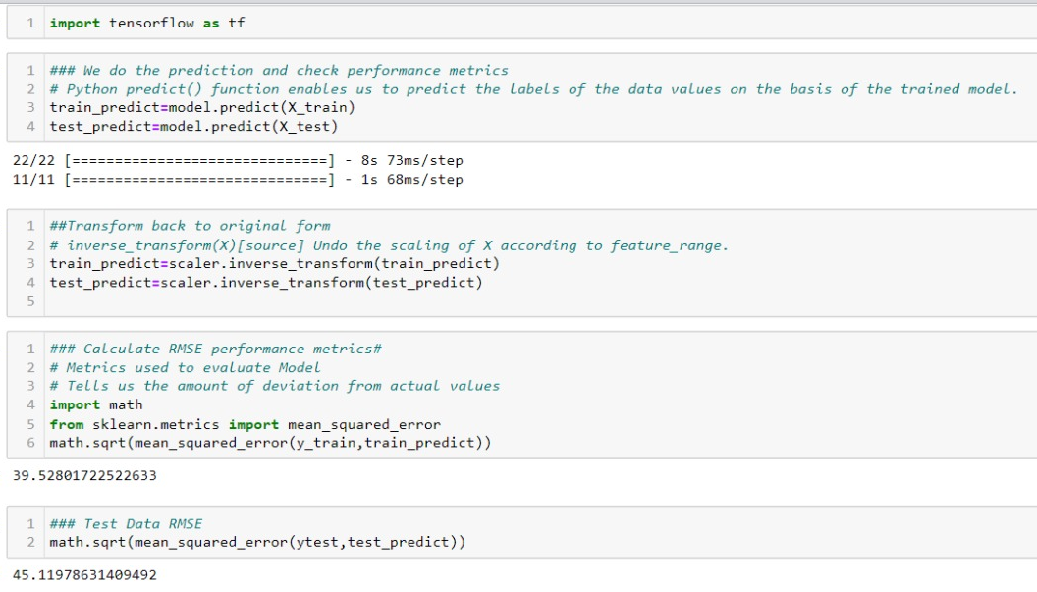
LSTM CODE
Mercury
Mercury is the closest planet to the Sun
Venus
Venus has a beautiful name but it’s hot
Mars
Despite being red, Mars is actually a cold place
17

Slide 18
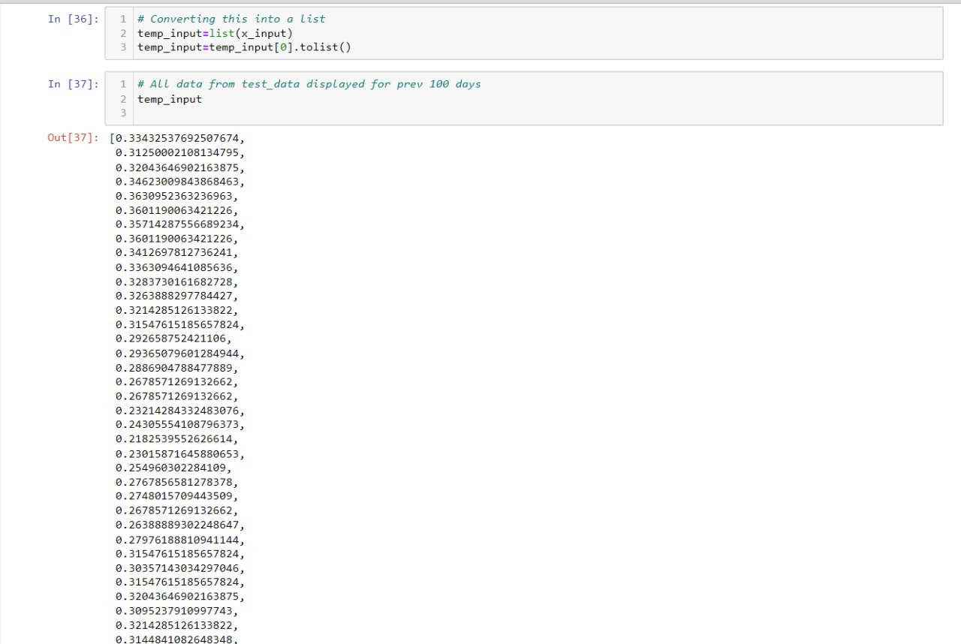
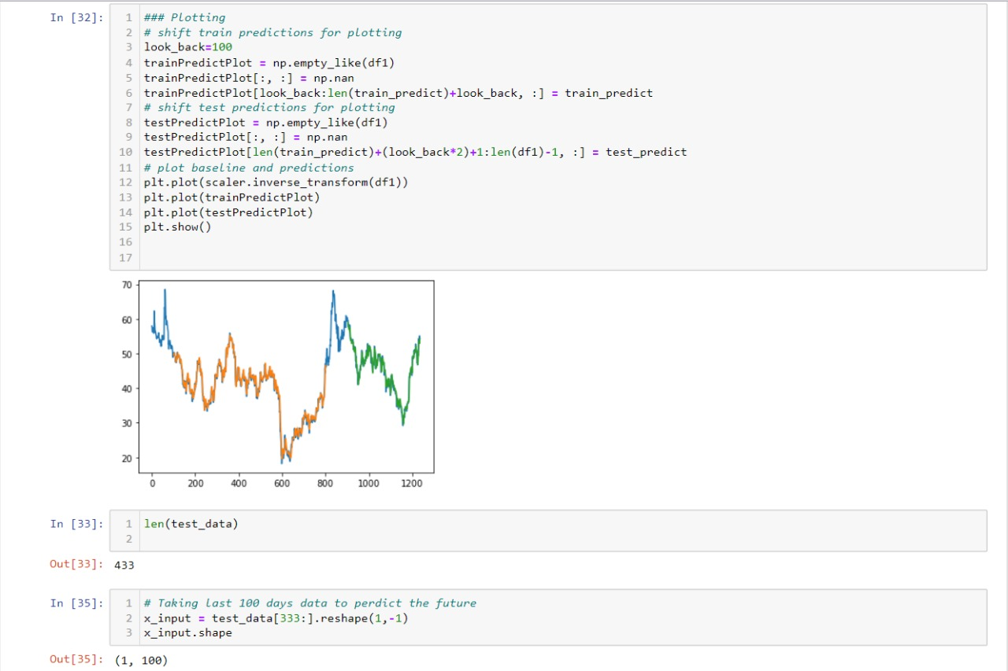
LSTM CODE
Mercury
Mercury is the closest planet to the Sun
Venus
Venus has a beautiful name but it’s hot
Mars
Despite being red, Mars is actually a cold place
18

Slide 19
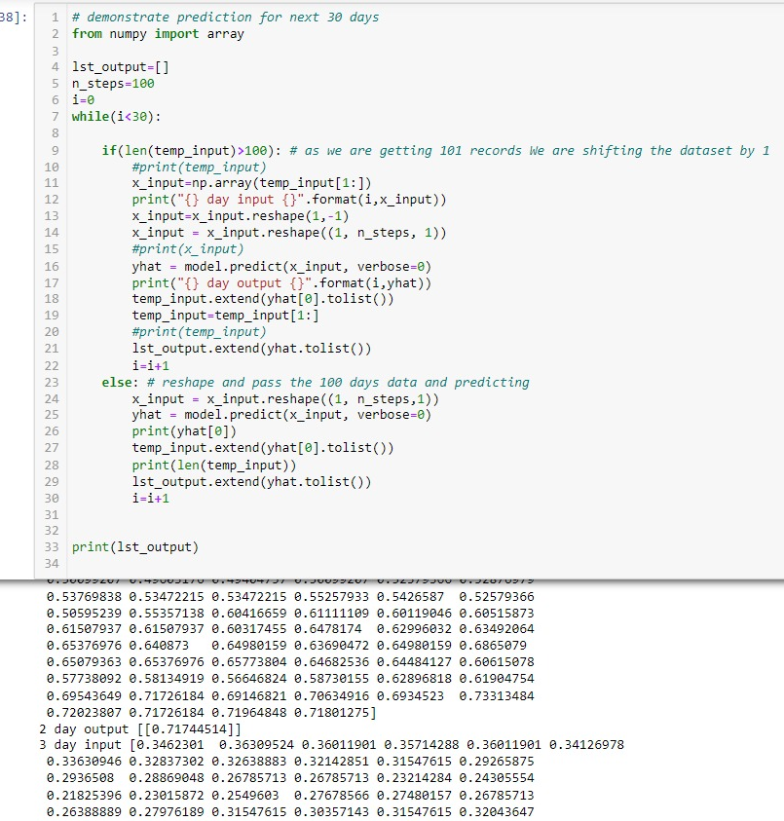
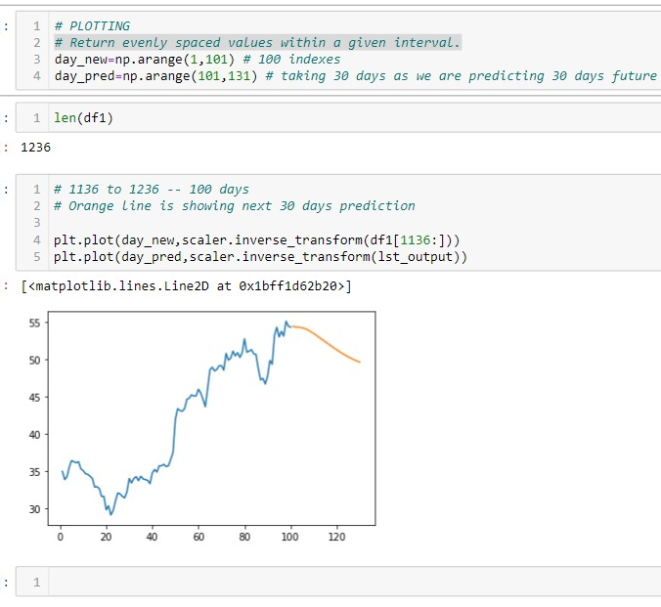
LSTM CODE
Mercury
Mercury is the closest planet to the Sun
Venus
Venus has a beautiful name but it’s hot
Mars
Despite being red, Mars is actually a cold place
19

Slide 20
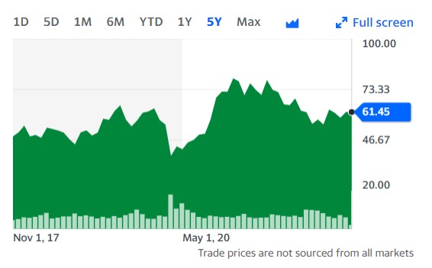
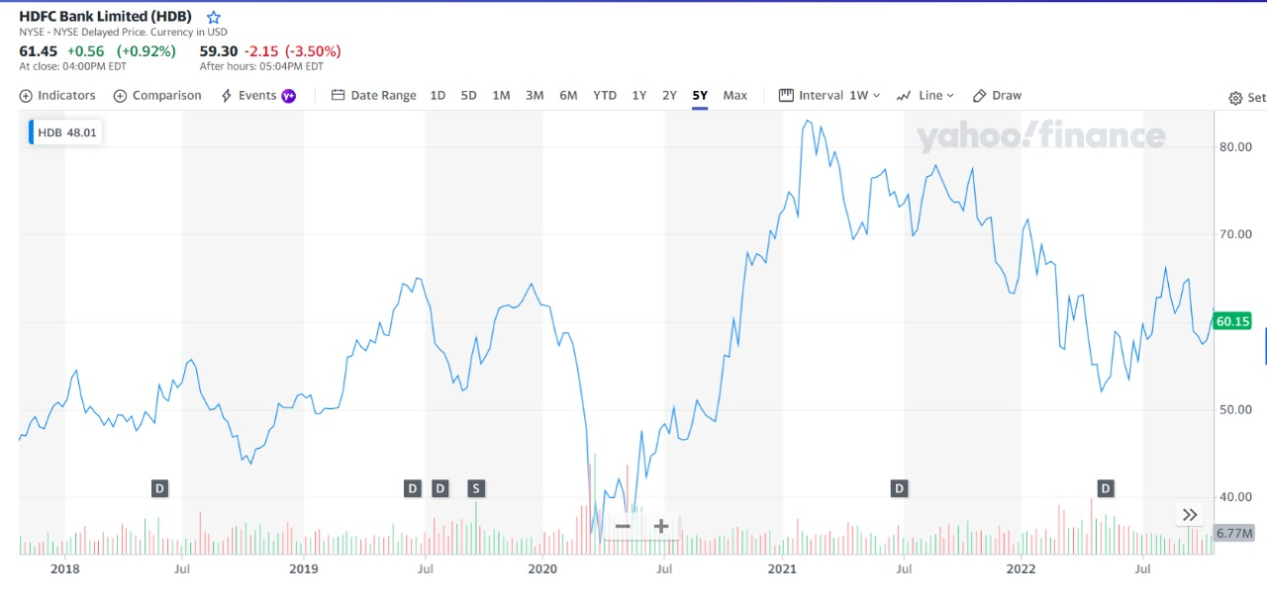
VISUALISATIONS HDFC
20

Slide 21
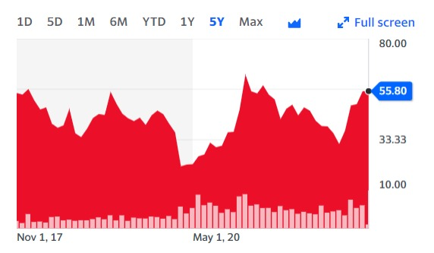
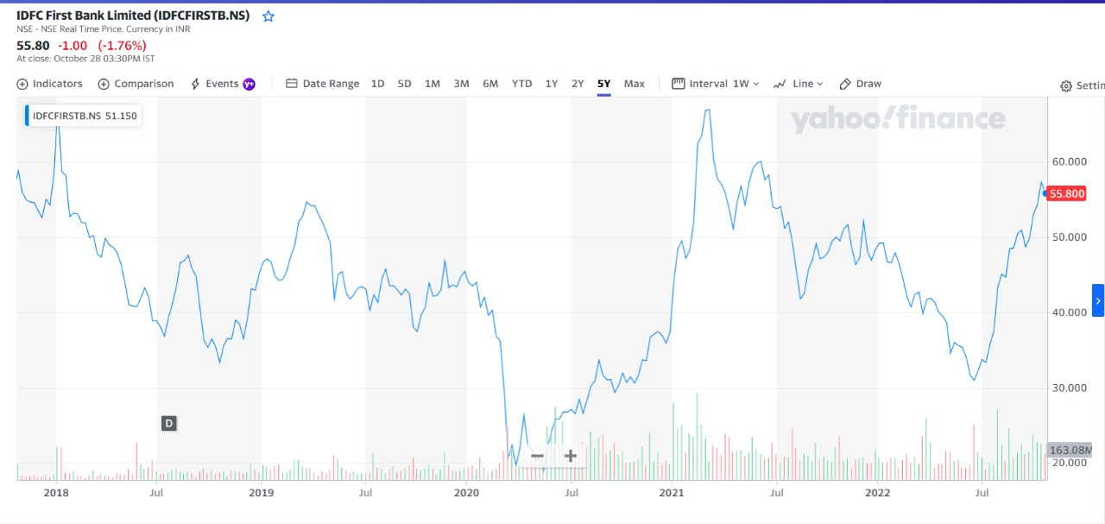
VISUALISATIONS IDFC
21

Slide 22

OUR TEAM
Aarohi Mhaske
J014
Sreeja Paul
J020
22

